Slide 1
Build PI Applications Faster with PI Web API Client Libraries
Marcos Vainer Loeff
Sr. Technology Enablement Engineer

Slide 2
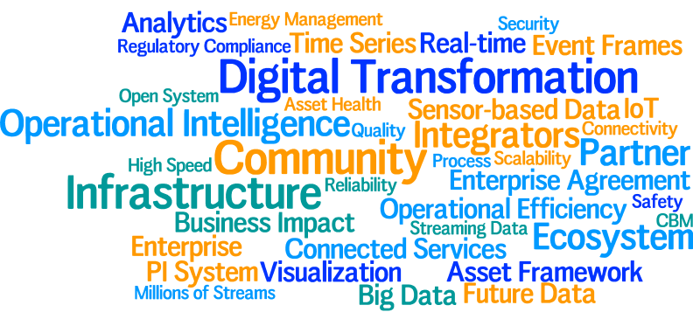
Conference Theme & Keywords

Slide 3
Agenda
What is PI Web API?
What are PI Web API client libraries?
Demo .NET Core Console Application
Installation
Authentication
Documentation
Retrieve basic PI Objects: PIElement, PIAttributes
Retrieve data in bulk
Update data in bulk
PI Web API Batch example
PI Web API Channels example
Web ID 2.0 client generation
Client libraries for other platforms
Q/A

Slide 4
What is PI Web API?

Slide 5
PI Web API
A suite of RESTful services for accessing and manipulating data in your PI System
Key functionality for
Retrieving and manipulating
Time Series Data
Assets
Event Frames
Indexing and searching
Notes:
The PI Web API is a suite of REST services that provide access to PI System data. The product provides the REST services needed to retrieve, create and edit time series, asset, and event frame data. PI Web API also includes support for indexing and searching metadata within the Asset Framework and PI Data Archive components of the PI System.

Slide 6
RESTful Services
HTTP-based
Traverse/route through proxies, firewalls
Mobile and cloud computing
Cross-platform
HTTP Semantics
“Resource-Oriented”
Comes with built-in security

Slide 7
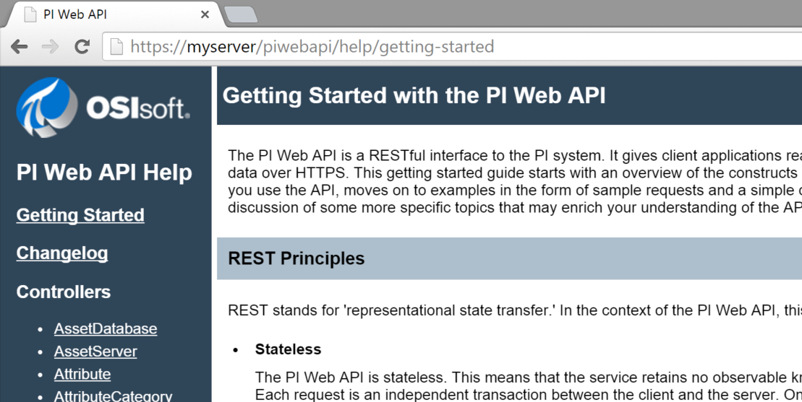
Online Tutorial

Slide 8
What are PI Web API client libraries?

Slide 9
What are PI Web API client libraries?
RESTful client libraries generated using Swagger specification
Swagger specification is available in PI Web API 2017+
All PI Web API methods available on the server-side are also available on each client library.

Slide 10
What are PI Web API client libraries?
With those libraries, developers don’t need to:
Generate the URL for each HTTP request.
Know the classes and methods of their platform in order to make HTTP requests. The library will use those methods under the hood for you.
Add the the authentcation header to each HTTP request.
As a result:
Developers will write code faster (less code is required) and easier (all methods are already available).
Some platforms support intellisense which makes it even easier to code

Slide 11
Demo .NET Core Console Application

Slide 12

Demo
Notes:
Nativate through PI Web API
Show help file

Slide 13
PI Web API client libraries for other platforms

Slide 14
PI Web API client libraries for other platforms
.NET Standard
.NET Framework (PI Web API Channels)
VBA
PHP
Java and Android
jQuery
AngularJS
Angular 5
R
Python
https://pisquare.osisoft.com/community/developers-club/blog/2017/11/01/pi-web-api-client-libraries-already-released

Slide 15
Marcos Vainer Loeff
mloeff@osisoft.com
Sr. Technology Enablement Engineer
OSIsoft, LLC
15

Slide 16

Questions
Please remember to…
Please wait for the microphone before asking your questions
Complete the Online Survey
for this session
UPDATED VERSION
COMING SOON
State your name & company

Slide 17







Merci
Thank You
Grazie
Optional: Click to add a takeaway you wish the audience to leave with.

